Slide 1
IBM University Engagement Project Submission
“Exploring the Power of Agentic AI with IBM Granite and LangFlow”

Slide 2

Project Title - Predictive Maintenance of Industrial Machinery (PS39)
Domain of Project – Manufacturing / Industrial Engineering
Student Name | Recent Passport Photo | Email ID | Mobile number [WhatsApp]
Mohammad Basheer Shabbir Shareef |  | Basheershareef2005@gmail.com | 7981841214

Slide 3
Problem Statement -
Problem Statement : Predictive Maintenance of Industrial Machinery
The Challenge Industrial fleets face catastrophic failures due to wear and thermal stress, but maintenance teams often struggle to anticipate these events before they occur. Information about machine health is buried within extreme volumes of sensor telemetry data. Without proactive, real-time intelligence, many organizations rely on reactive maintenance, leading to costly downtime and inefficient operations.
The Objective Build an intelligent web application using machine learning that delivers real-time, proactive industrial asset monitoring. The solution should:
Predict Failure Types – Anticipate specific anomalies including Tool Wear, Heat Dissipation, Power Failure, and Overstrain.
Live Sensor Input – Accept and process real-time telemetry such as Rotational Speed, Torque, Air Temperature, and Process Temperature.
Diagnostic Engine – Combine an IBM watsonx AutoAI Machine Learning model (Snap Random Forest) with rule-based mechanical overrides.
Mitigation Protocols – Provide actionable, step-by-step mitigation strategies based on the specific anomaly detected.
Visualization Dashboard – Display real-time telemetry, model confidence levels, and safety warnings in an intuitive Streamlit interface.

Slide 4
Technology Used
Tech Stack (Mandatory)
Use any one of the following approaches:
LangFlow + IBM watsonx.ai + Granite Models
IBM Cloud Agentic Lab with IBM Granite Models
Replicate with LangChain + RAG + IBM Granite Models
I used IBM watsonx.ai (AutoAI) + Streamlit + Python
IBM watsonx AutoAI: For automated data preprocessing, model training, hyperparameter optimization, and API deployment.
Snap ML (Random Forest): The high-performance machine learning algorithm selected for fast, multi-class inference.
Streamlit: For designing the interactive web dashboard and user interface.
Python & Requests: For securely transmitting JSON payloads from the frontend application to the cloud backend.

Slide 5
Proposed Solution -
Machine Learning (AI) Insights:
Data Analysis: Analyzes real-time sensor data—like temperature, rotational speed, torque, and tool wear—collected from your machines.
Failure Classification: Uses a trained machine learning model conceptually optimized for tasks like F1 Macro-averaging (to handle rare failure cases effectively). This model conceptualizes predictions on when a failure might occur and what type of failure it is likely to be (e.g., Tool Wear, Heat Dissipation, Power Failure, or Overstrain).
Secure API: Accesses these predictions through a deployed endpoint, possibly conceptualizing standard cloud or edge services.
Rule-Based Safety Logic:
Override Protocols: Operates a concurrent rules engine containing hardcoded mechanical safety thresholds (e.g., maximum permissible temperature, extreme speed-to-torque ratios).
Immediate Action: If any of these critical limits are conceptually breached, the rules-based system can immediately trigger alarms or shutdown protocols, prioritizing safety even if the ML model is still processing or has lower confidence.

Slide 6
Streamlit component Used -
1) Streamlit Input Panel - The interactive sidebar where operators manually enter or adjust real-time machine telemetry, such as rotational speed, torque, and temperatures.
2) IBM watsonx AutoAI Engine - The cloud backend that receives the sensor data and processes it using optimized Machine Learning pipelines to generate failure predictions.
3) Snap Random Forest Classifier - The high-performance machine learning algorithm selected by AutoAI. Fast and efficient for real-time multi-class failure classification.
4) Streamlit Diagnostic Output - The main visual dashboard that displays the AI-generated results, including failure probability charts, risk levels, and step-by-step mitigation protocols.
5) Rule-Based Safety Engine - Hardcoded mechanical logic within the app that overrides the AI to trigger immediate warnings if critical physical thresholds (like extreme heat) are breached.
6) Streamlit Secrets Vault - The secure configuration system (secrets.toml) that safely stores and injects your IBM Cloud API key to connect the public frontend to the private backend.

Slide 7
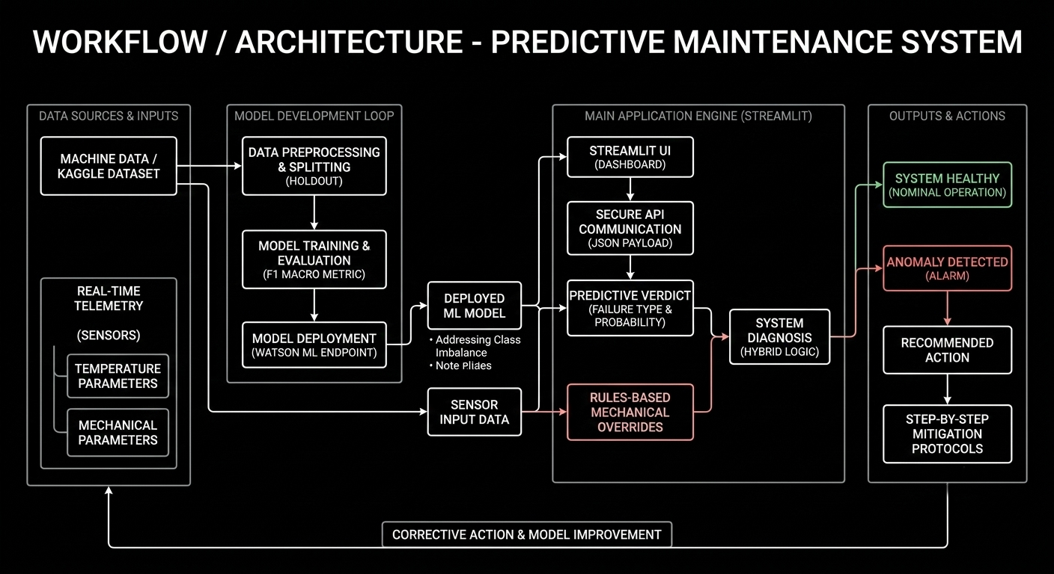
Architecture blueprint

Slide 8

Role of Agentic AI in the solution
Role of Machine Learning in Predictive Maintenance
Machine Learning enables the system to function as an intelligent, predictive engine rather than relying solely on manual, reactive alarms. Using IBM watsonx.ai, the model identifies complex, hidden patterns in sensor data that precede physical failures.
Multi-Dimensional Analysis: The ML model (Snap Random Forest Classifier) understands how multiple variables—such as how torque interacts with rotational speed and temperature simultaneously—affect the machine's health in real-time.
Catching Rare Anomalies: By optimizing for the F1 Macro score, the AI effectively handles the extreme class imbalance in industrial data (96.5% healthy vs. 3.5% failures), ensuring it catches rare events like Tool Wear or Heat Dissipation failures instead of just guessing "Healthy."
Context-Aware Diagnostics: Instead of just triggering a generic "Error," the ML model categorizes the exact type of failure and outputs a confidence-scored diagnostic verdict.
Overall, Machine Learning makes the system proactive and safe, acting like a smart digital diagnostic technician that helps operators maintain optimal uptime.

Slide 9
Technology Used
IBM Grainte model - for eg – ibm-granite-3-2-8b – For natural language understanding, reasoning, and personalization
IBM Cloud – It provides the infrastructure to build, deploy, and scale the Nutrition Agent efficiently. IBM Cloud enables a reliable, secure, and scalable environment for deploying the Nutrition Agent.
IBM watsonx.ai (AutoAI) – This is the core technology shown in your picture. It is the IBM Cloud service you used to automatically train, evaluate, and deploy your predictive maintenance model.
Streamlit – The framework you used to build the interactive web dashboard for your app.
Python – The programming language used to connect your Streamlit app to the IBM watsonx.ai prediction endpoint via REST API.
IBM Watsonx.ai - For model deployment, embeddings, and AI governance
Vector Database (FAISS/Chroma) – For RAG-based nutritional data retrieval

Slide 10
Novelty and Uniqueness
Hybrid Diagnostic Intelligence: Merges ML probabilistic scoring with hard-coded rule-based overrides to ensure critical physical thresholds are never ignored.
Advanced Imbalance Handling: Designed specifically to detect rare anomalies by optimizing for the F1 Macro metric, ensuring it doesn't just guess "Healthy".
Instant Mitigation Protocols: Doesn't just flag an error; it provides actionable, step-by-step resolution paths for operators.
Secure Cloud Deployment: Utilizes Streamlit's secrets management to securely connect a public-facing dashboard with a private IBM API.

Slide 11
Git Hub Link
Git Hub Link : https://github.com/Basheer78654/streamlit-app.git
Streamlit App link : https://app-app-86cuhmm55zzarihythmpxo.streamlit.app/
·
·
·

Slide 12
Future Scope
Direct IoT Sensor Integration: Future versions can replace manual input by hooking directly into PLC (Programmable Logic Controller) streams via protocols like MQTT, allowing for 100% automated real-time telemetry ingestion.
Automated Maintenance Ticketing: Integration with factory ERP systems (like SAP or Maximo) to automatically generate and assign maintenance work orders when an anomaly reaches a high confidence threshold.
Expanded Machine Topologies: The model can be retrained with broader datasets to encompass different types of industrial machinery (e.g., CNC milling machines, hydraulic presses) beyond the current profiles.
·
·
·

Slide 13


